Slide 1
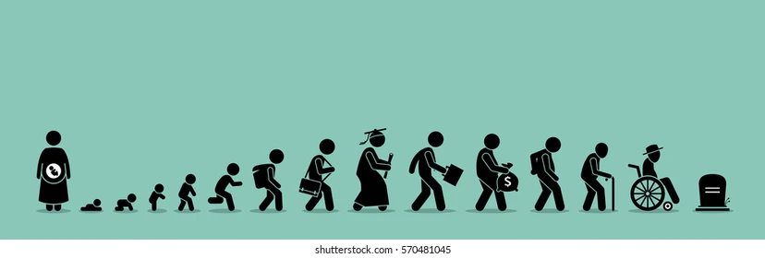
What is Life?

Slide 2
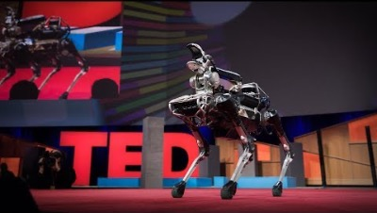

Slide 3
Life & Living Organism
Life - living beings - non-living matter.
what are the characteristics that distinguish a living organism from a non-living entity?
There is a short definition “Life is self-reproduction with variations”
definition by NASA: “Life is a self-sustaining chemical system capable of Darwinian evolution”

Slide 4
Life and Living organism
Life :
a process that takes place in highly organized organic structures and
is characterized by being preprogrammed, interactive, adaptative and evolutionary.
If life is the process, living beings are the system in which this process takes place.
We can define life in very different ways depending on the context and the focus we want to give to the definition. For example;
life as the period from birth to death or as the condition that occurs only in living organisms.
life is a wonderful and ever-changing process that occurs in highly organized structure that we identify as living entities.
Wikipedia define life as “a characteristic that distinguishes physical entities that have biological processes ….. from those that do not …”

Slide 5
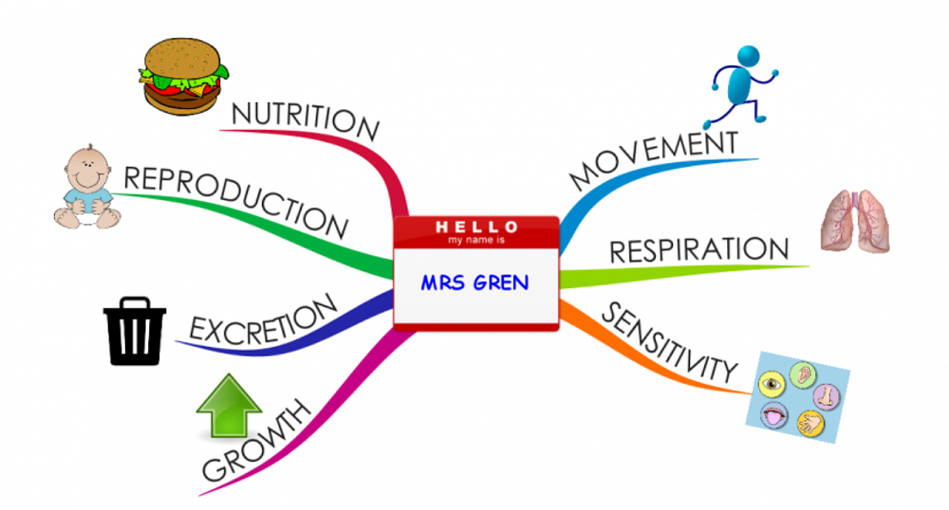
Characteristics of Living Organism (MRS GREN)
Living things display certain characteristics that may be absent from material objects.
MRS GREN is an acronym often used to help remember all the necessary features of living organisms: Movement, Respiration, Sensitivity, Growth, Reproduction, Excretion and Nutrition.

Slide 6
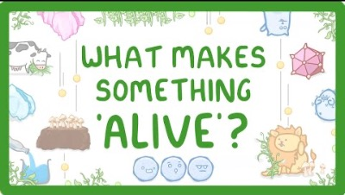
Characteristics of Living Organism

Slide 7
Characteristics of Living Organism (depends on the cell)
Order (cellular organisation)
Organisms are highly organized, coordinated structures that consist of one or more cells.
Sensitivity or Response to Stimuli
Organisms respond to diverse stimuli. For example, plants can bend toward a source of light, climb on fences and walls, or respond to touch
Reproduction
Single-celled organisms reproduce by first duplicating their DNA, and then dividing it equally as the cell prepares to divide to form two new cells. Multicellular organisms often produce specialized reproductive germline cells that will form new individuals.
Growth and Development
Organisms grow and develop following specific instructions coded for by their genes.
Regulation and Homeostasis
Even the smallest organisms are complex and require multiple regulatory mechanisms to coordinate internal functions, respond to stimuli, and cope with environmental stresses.
In order to function properly, cells need to have appropriate conditions such as proper temperature, pH, and appropriate concentration of diverse chemicals. For example, an organism needs to regulate body temperature through a process known as thermoregulation.
Energy Processing
All organisms use a source of energy for their metabolic activities. Some organisms capture energy from the sun and convert it into chemical energy in food (photosynthesis); others use chemical energy in molecules they take in as food (cellular respiration).

Slide 8
Characteristics of Living Organism (modern version)
Living organisms share seven traits: organic nature, high degree of organization, pre-programming, interaction (or collaboration), adaptation, reproduction and evolution,
Organic nature and highly organized structures. Living matter is organic because it is based on carbon chemistry and molecular interactions take place as they are not present in all living beings.
Pre-programming. Every living entity has a software (a pre-programme) in its genetic material that contains the instruction manual necessary for both its construction (morphology) and its functioning (physiology).
Interaction and adaptation.
we can see countless interactions between living beings and with their environment necessary for survival and reproduction. We can see interactions at the molecular level (e.g., allosteric interactions, metabolic pathways, cellular signaling, quorum sensing), in the relationships between organisms of the same or different species (e.g., sexual reproduction, symbiosis, infection, parasitism, predator–prey, or sound language), or between living forms and the environment (e.g., photosynthesis or physiological/anatomical interactions for swimming or flying).
Life is adaptative because species adapt to environmental changes modifying their physiology or metabolism, for instance reducing heartbeat during hibernation (e.g. the grizzly bear Ursus arctos horribilis) or synthesizing fat from excess sugar to increase the energy reserves of the body (e.g. Homo sapiens), plants can bend toward a source of light, climb on fences and walls, or respond to touch.
Reproduction and Evolution. Another property of living beings is their ability to perpetuate themselves and thus make it possible for the species not to disappear and to evolve. Reproduction can be observed at the molecular (DNA replication), cellular (mitosis, meiosis, binary division), and organismal (sexual and asexual) levels. All species have the capacity to evolve, and this property is unique to life. Evolution allows living beings to adapt to new circumstances and the best genomes are selected and transmitted to the next generations.

Slide 9
Viruses
We cannot say whether a virus is a living thing or not without defining what is life and what is a living thing. Obviously, if we take the cell as the minimum vital unit, we cannot consider viruses as living entities.
Firstly, viruses, like all cellular entities in nature, are composed of organic molecules; a virus consists of a nucleic acid (DNA or RNA), which is its genetic material as in all living things, and a protein capsid encoded by the viral genome that protects the viral genetic material and participates in the propagation of the virus in the host; viral capsids show fascinating dynamics during the viral life cycle.
Secondly, viruses are highly organized structures. There is an astonishing diversity of organization and geometric design of viruses, requiring only a few different structural subunits of the capsid to construct an infectious particle.
The third feature common to all living things is that they are pre-programmed, and viruses also fulfill this characteristic because in their genetic material are written the instructions to make new viruses capable of infecting new cells or organisms. Viruses in their genome have the necessary instructions to make new viruses, and in this they are the same as any other living thing.
Two other characteristics of living organisms are the ability to interact with other living organisms (interaction) and to adapt genetically to new circumstances (adaptation). Viruses interact with their host in multiple ways: during infection, when their genes are expressed and their genome replicated, when virions are formed, when they integrate into the genome of the host cell, or when they engage in horizontal gene transfer processes. Viruses not only interact with their host, but also adapt by generating new variants that increase their ability to infect other cells, or by taking control of cell metabolism for their own benefit, or even to escape the immune response
In terms of reproduction and evolution, which are two closely related processes, viruses reproduce in the host cell and evolve through changes in their genome. Viral evolution, like that of all living things, refers to the heritable genetic changes that a virus accumulates during its life cycle, which may arise from adaptations in response to environmental changes or host immune response.

Slide 10
What about Robots?
What is the difference between life, living being and a robot?
Life is the vital process and the living being is the system where the vital process takes place.
A robot would be an artificially organized, pre-programmed and interactive system, but unlike a living being it is not alive because a ROBOT is neither organic, nor does it reproduce, adapt, or evolve.
A robot or a population of robots cannot “reproduce and evolve” on its own, without the intervention of its "creator" (the human being), it will always need to be built or programmed by an engineer to do so.

Slide 11
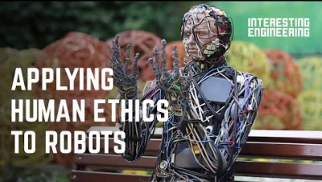

Slide 12
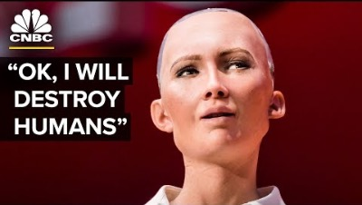

Slide 13

Can we create new senses for humans?

Slide 14
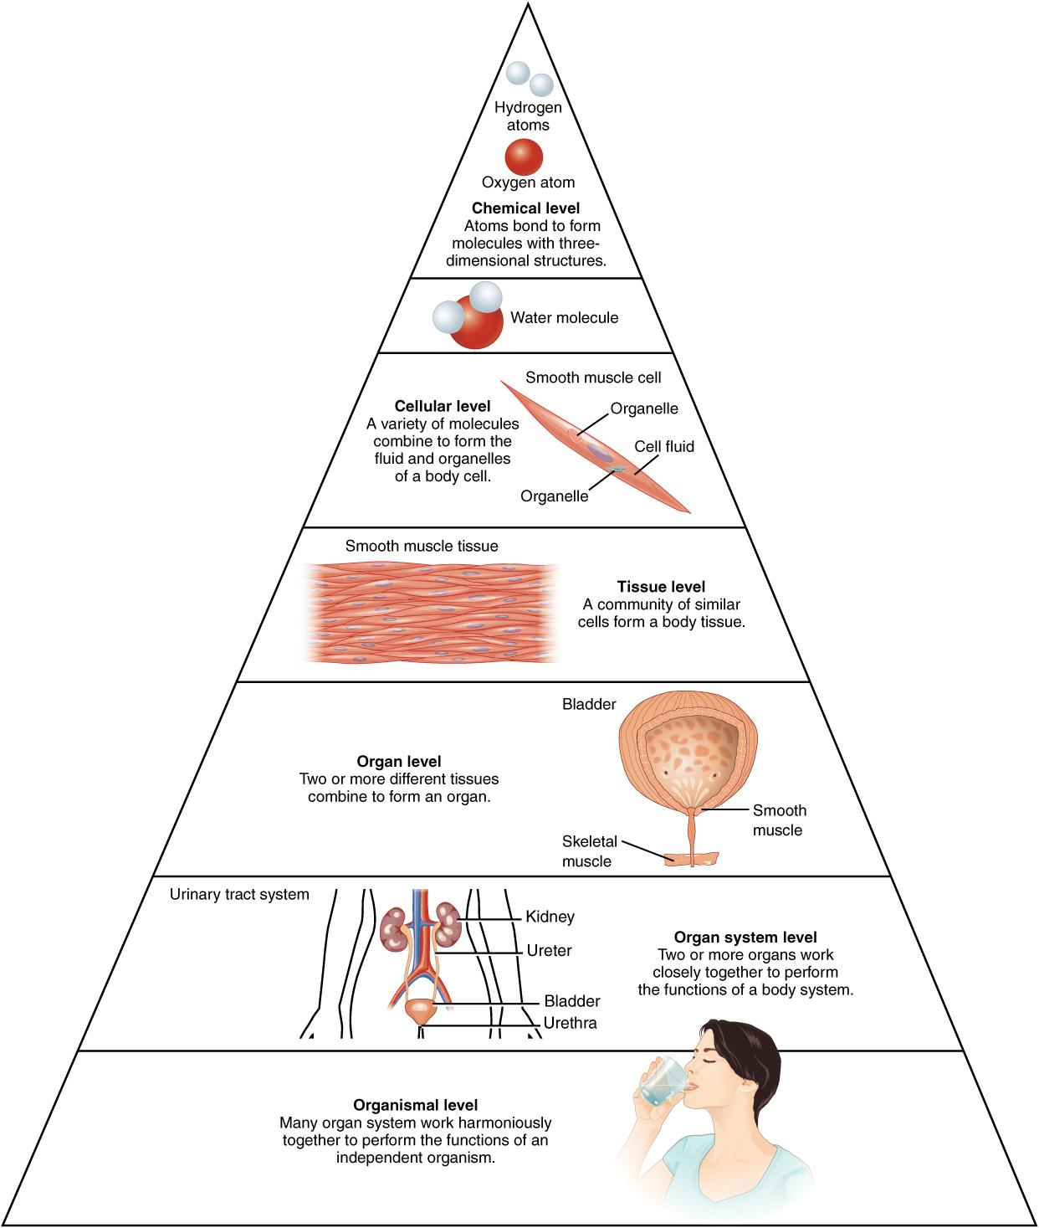
The Organization of Life

Slide 15
The Organization of Life
Living things are highly organized and structured, following a hierarchy that can be examined on a scale from small to large. The atom is the smallest and most fundamental unit of matter.
Levels of organization are structures in nature, usually defined by part-whole relationships, with things at higher levels being composed of things at the next lower level. Typical levels of organization that one finds in the literature include the atomic, molecular, cellular, tissue, organ, organismal, group, population, community, ecosystem, landscape, and biosphere levels.
The organization of life is a hierarchy of levels of increasing complexity.
Cellular.
Organismal.
Populational.

Slide 16
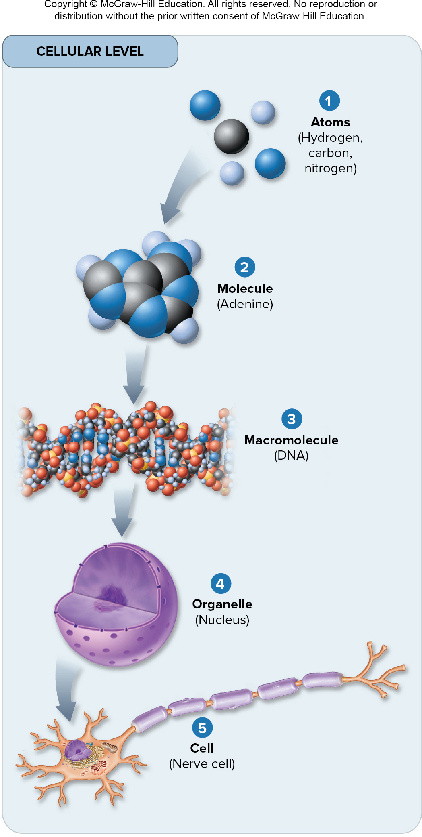
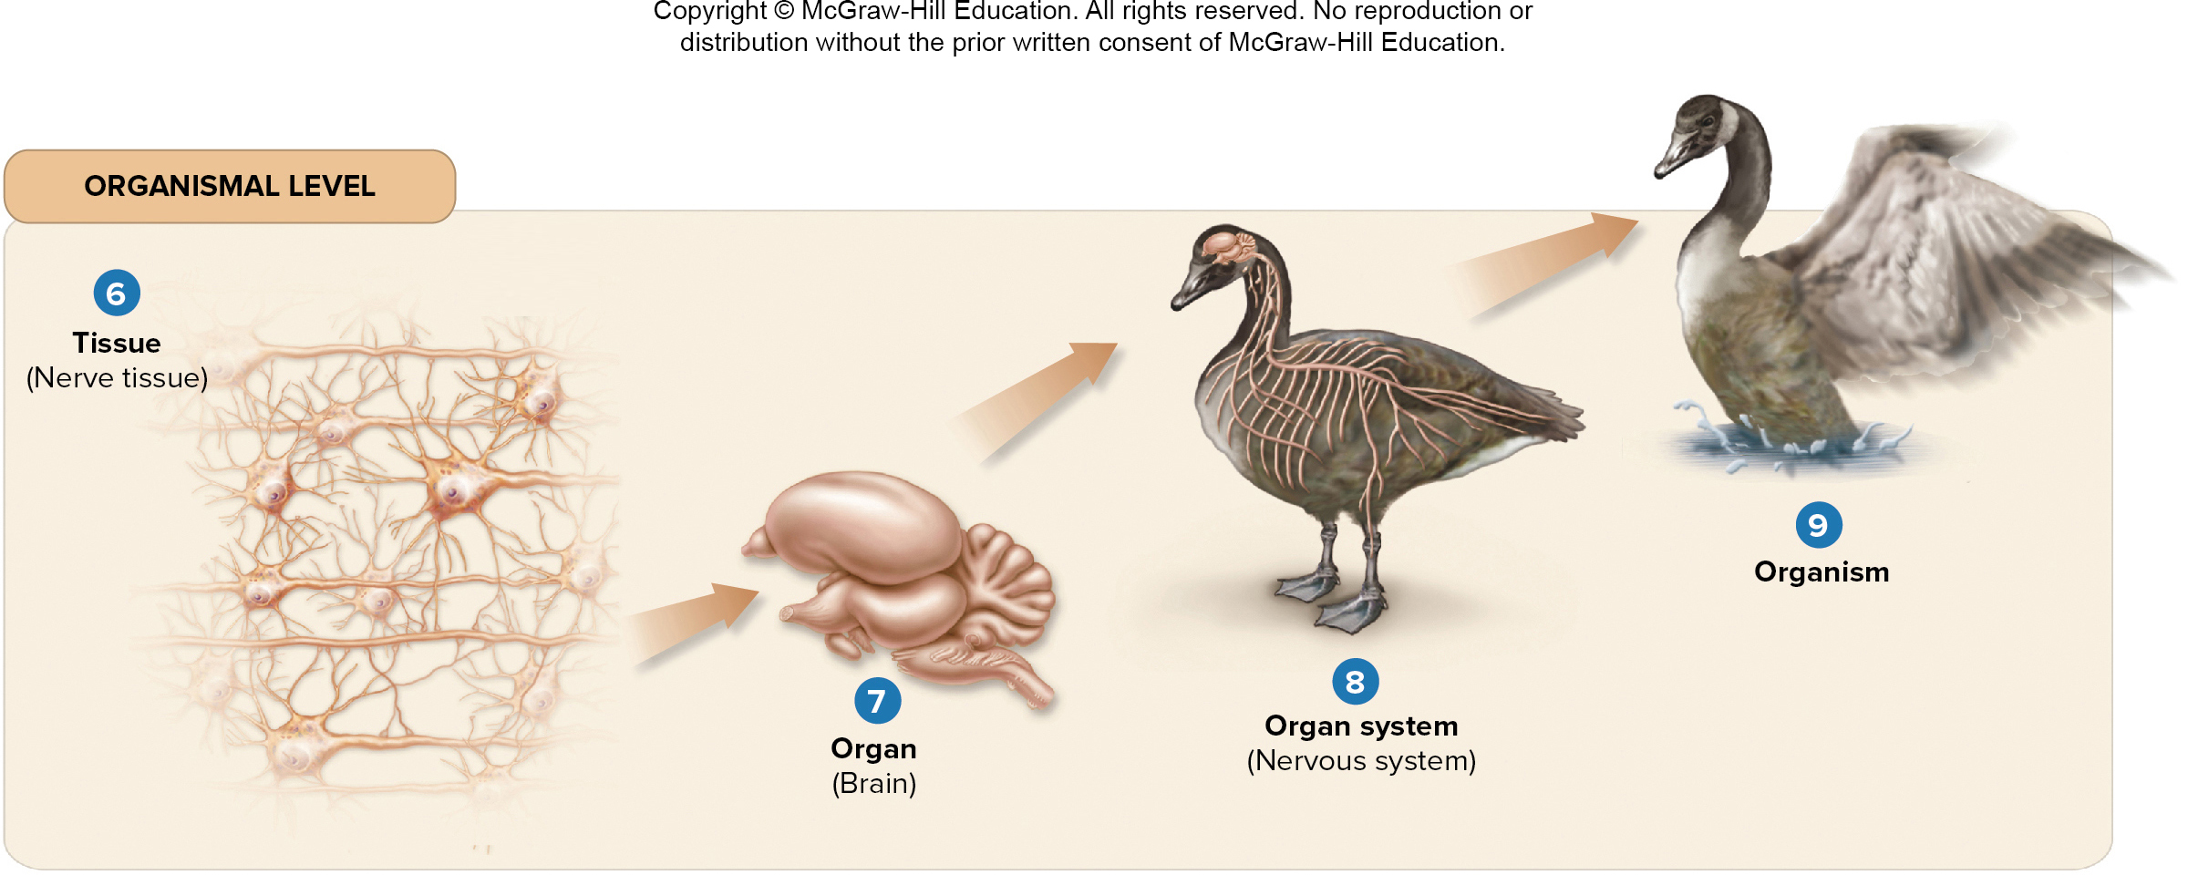
Levels of Organization

Slide 17
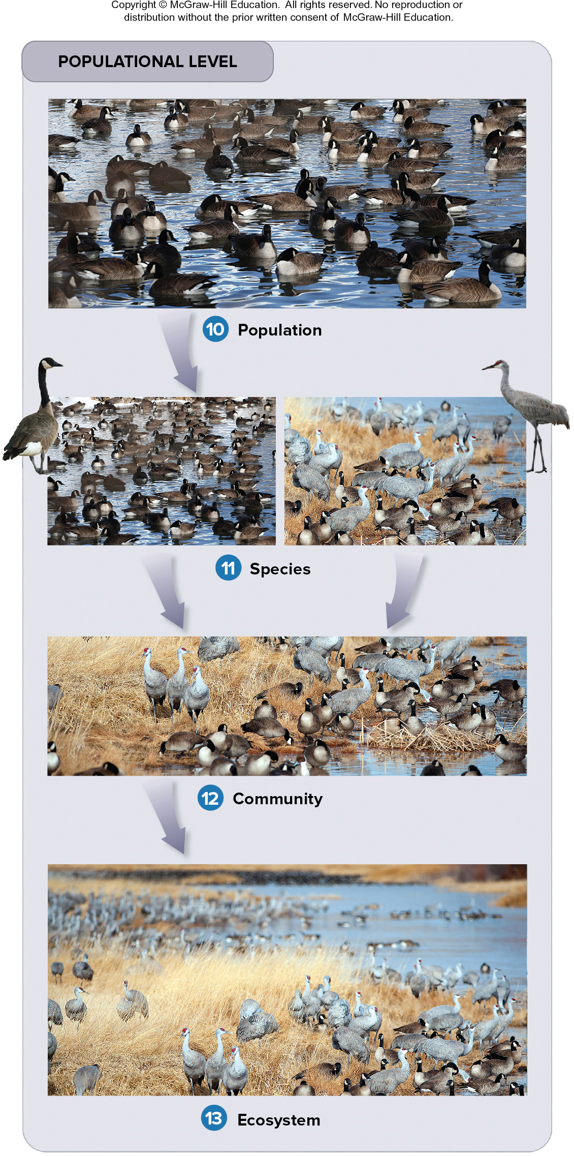
Levels of Organization

